Slide 1




Effective and Scalable Clustering on Massive Attributed Graphs
Renchi Yang, Jieming Shi, Yin Yang, Keke Huang, Shiqi Zhang, Xiaokui Xiao
April 2021
The Web Conference 2021
Notes:
Thanks for attending, This is Yang Renchi from Nanyang Technological University.
Today I would like to present you with our effective and scalable clustering algorithm for large-scale attributed graphs. This is a joint work with HK PolyU, HBKU and NUS. (click)

Slide 2
Outline
Problem Definition
Existing Work
Challenges
Objective
Proposed ACMin
Experiments
Notes:
Here is the outline for today’s presentation.
First, I will present the definition of our studied problem, followed by an overview of existing work to it.
Then the challenges of the problem will be listed.
After that, I will show our objective function to solve the problem, followed by introducing our proposed ACMin algorithm for solving it.
Finally, some interesting experimental findings will be shared. (click)

Slide 3
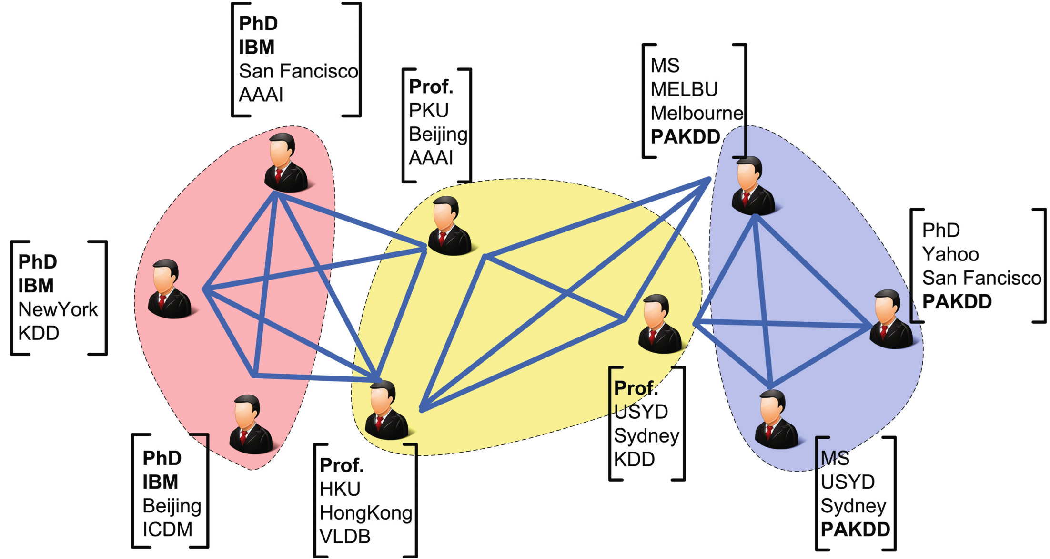
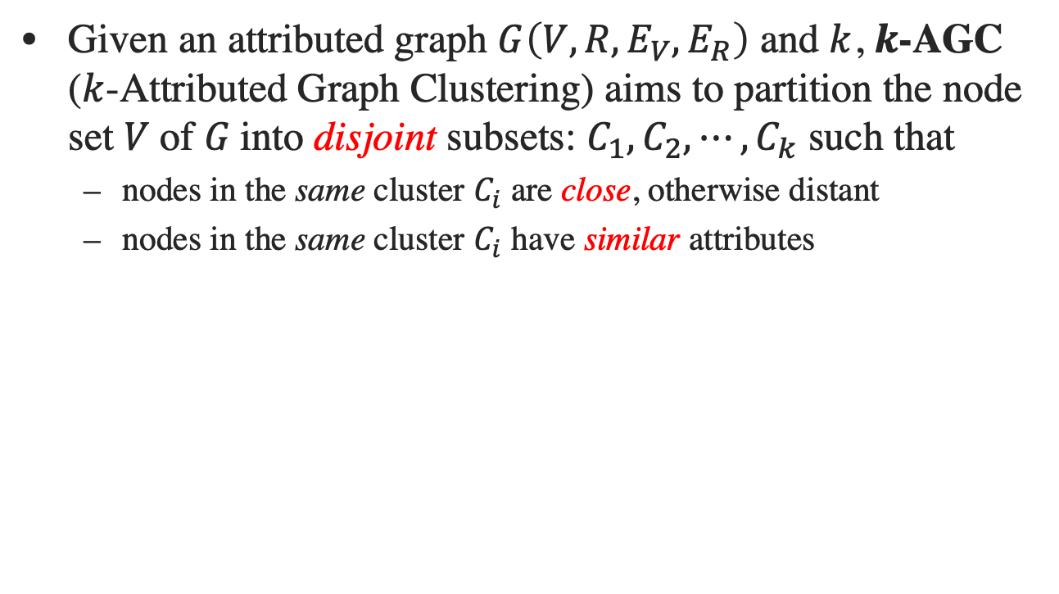
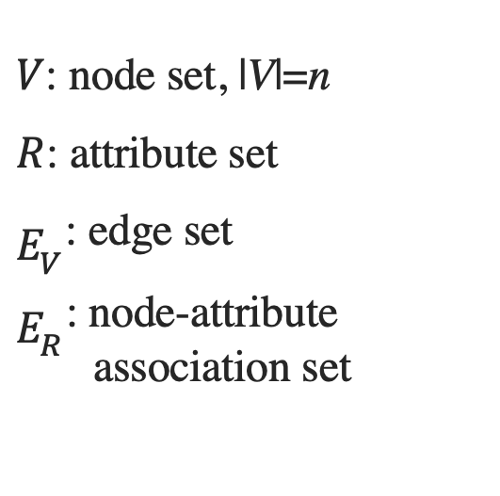
Problem Definition
Given an attributed graph $G\left(V,R,E_{V},E_{R}\right)$ and $k$, $k$-AGC ($k$-Attributed Graph Clustering) aims to partition the node set 𝑉 of 𝐺 into disjoint subsets: $C_{1},C_{2},⋯,C_{k}$ such that
nodes in the same cluster $C_{i}$ are close, otherwise distant
nodes in the same cluster $C_{i}$ have similar attributes
$V$: node set, |V|=n
$R$: attribute set
$E_{V}$: edge set
$E_{R}$: node-attribute association set
Notes:
Given an attributed graph G with node set V, attribute set R, edge set E_V and node-attribute association set E_R, as well as the desired number of clusters k, k-AGC problem aims to split the node set V into k disjoint subsets: C1, C2, …, Ck， such that (click)
First, nodes in the same cluster Ci are close to each other and nodes in two clusters are distant from each other; (click)
Second, nodes in the same cluster Ci share similar attribute values. (click)
For example, given a social network, each node is a user and each edge represents a friendship.
We can see from the red part, k-AGC aims to group users that are PhDs, work in IBM, as well as have close friendship relationships to each other as a cluster. (click)

Slide 4
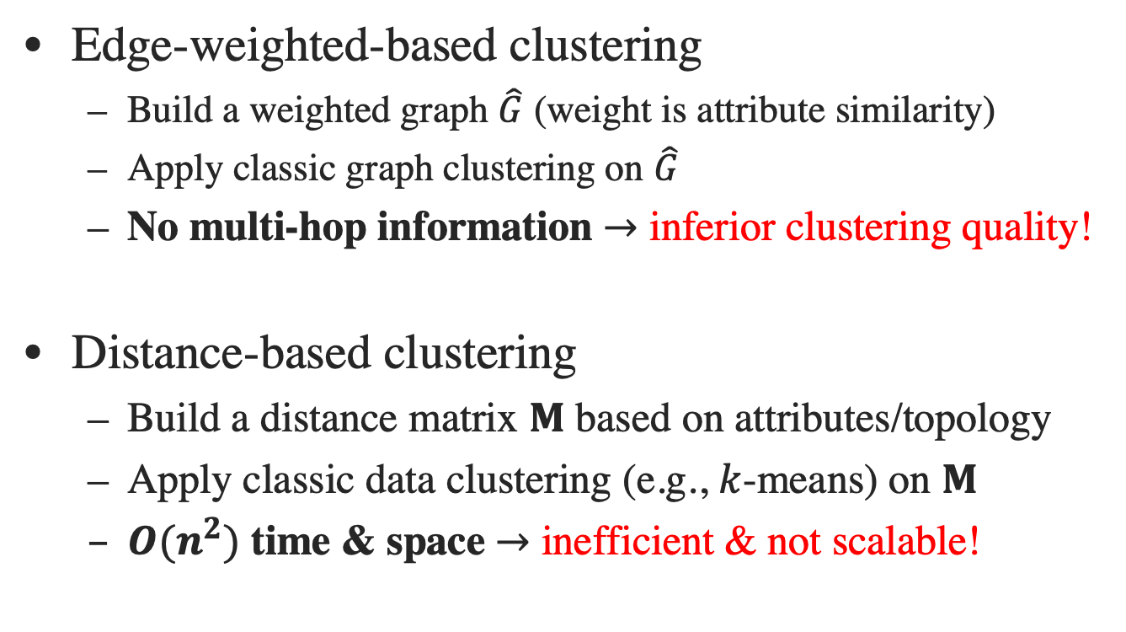
Existing Work
Edge-weighted-based clustering
Build a weighted graph $\hat{G}$ (weight is attribute similarity)
Apply classic graph clustering on $\hat{G}$
No multi-hop information $→$ inferior clustering quality!
Distance-based clustering
Build a distance matrix $M$ based on attributes/topology
Apply classic data clustering (e.g., $k$-means) on $M$
${O(n}^{2})$ time & space $→$ inefficient & not scalable!
Notes:
There exist numerous previous work to k-AGC, which can be mainly categorized into four categories.
The first one is edge-weighted-based. These methods weight each edge in the attributed graph via the similarity of two ending nodes’ attributes, and apply classic graph clustering technique on the weighted graph to generate clusters. However, they fail to capture multi-hop topology proximities and attribute similarities between two nodes, thereby suffering from inferior clustering quality. (click)
The second methodology constructs a distance matrix M to capture capture multi-hop topology proximities and attribute similarities between all node pairs and employ k-Means on M to obtain clusters. They require n squred time and space overheads, thus fail to process large attributed graphs efficiently. Note that n is the number of nodes in the graph. (click)

Slide 5
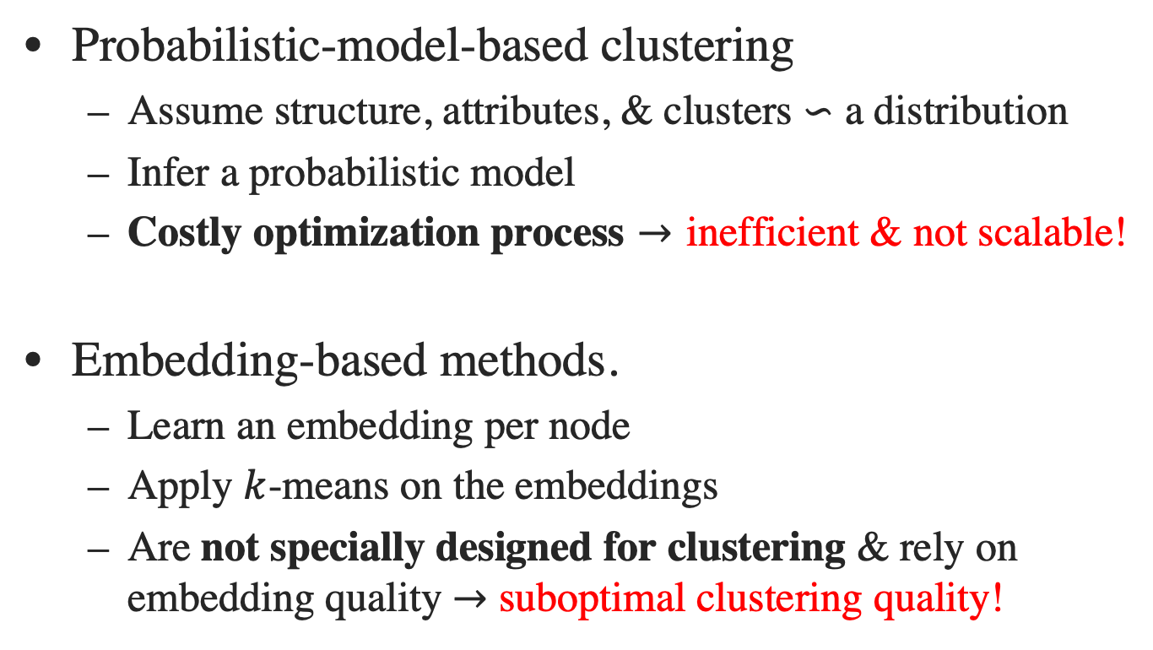
Existing Work
Probabilistic-model-based clustering
Assume structure, attributes, & clusters $∽$ a distribution
Infer a probabilistic model
Costly optimization process $→$ inefficient & not scalable!
Embedding-based methods.
Learn an embedding per node
Apply $k$-means on the embeddings
Are not specially designed for clustering & rely on embedding quality $→$ suboptimal clustering quality!
Notes:
The third category of methods are based on Probabilistic models, which involve a large number of parameters and an expensive optimization process. They can not scale to large datasets either. (click)
The fourth category of methods are embedding-based. They learn an embedding vector for each node such that the embedding can capture the topology and attribute information surrounding the node. After that, k-Means is applied on the embeddings to generate clusters. These methods yield suboptimal clustering quality due to that they are not specifically designed for clustering purpose and highly rely on the embedding quality. (click)

Slide 6
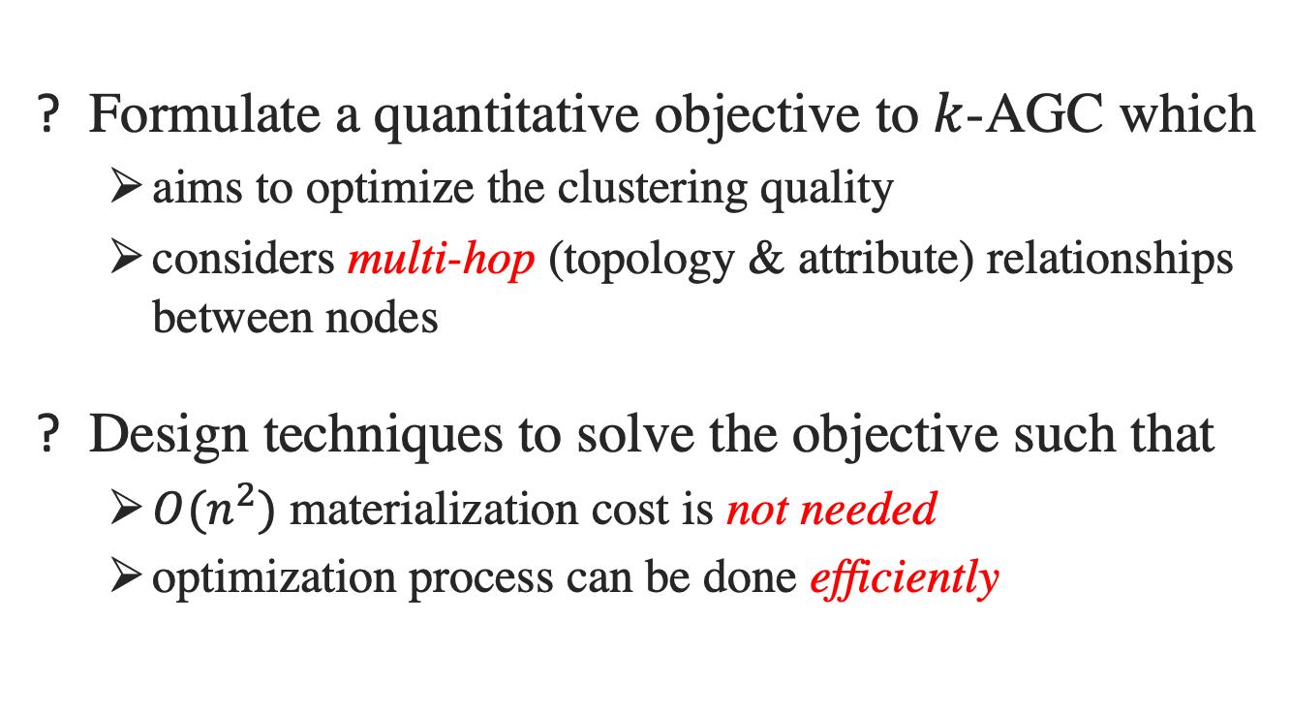
Challenges
Formulate a quantitative objective to $k$-AGC which
aims to optimize the clustering quality
considers multi-hop (topology & attribute) relationships between nodes
Design techniques to solve the objective such that
${O(n}^{2})$ materialization cost is not needed
optimization process can be done efficiently
Notes:
Therefore, we face several challenges to solve k-ADC problem.
First, we need a measurement to quantify the quality of clustering result, which can also guide us to derive our objective to cluster. This objective should take into account the multi-hop topology proximities and attribute similarities between nodes, which can improve the clustering quality as confirmed in prior work.
Second, we need to avoid quadratic materialization overheads, as well as substantial parameters and expensive optimization processes. (click)

Slide 7
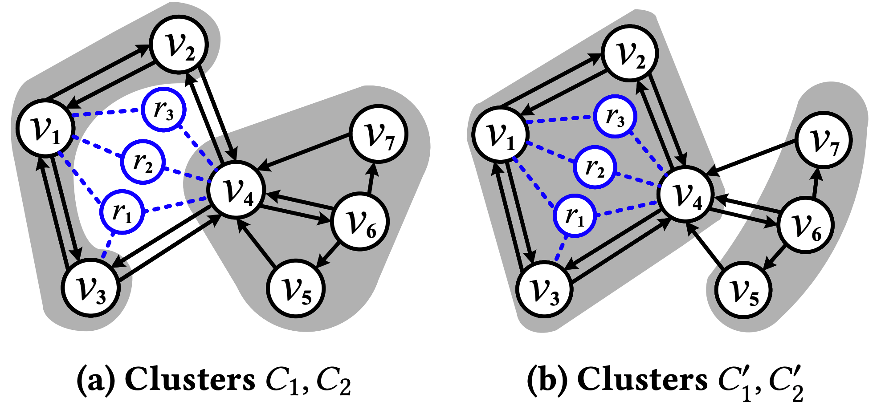
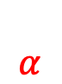
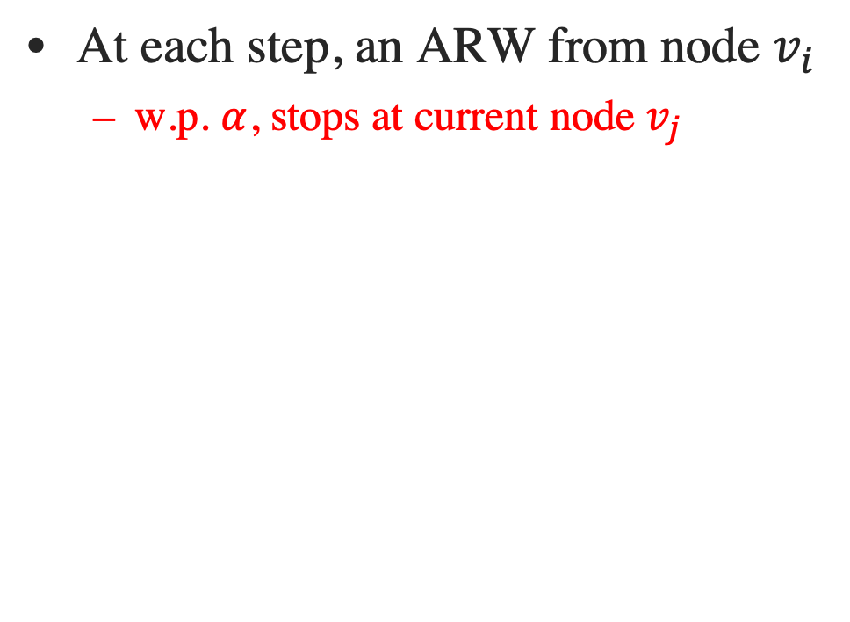
Objective: Attributed Random Walk (ARW) Model
At each step, an ARW from node $v_{i}$
w.p. $α$, stops at current node $v_{j}$
$$α$$
Notes:
Next, I’d like to introduce our attribute random walk model for capturing multi-hop topology proximities and attribute similarities between nodes.
Let’s consider an ARW from a node vi, then at each step, the ARW stops at current node vj with probability alpha. (click)

Slide 8
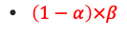

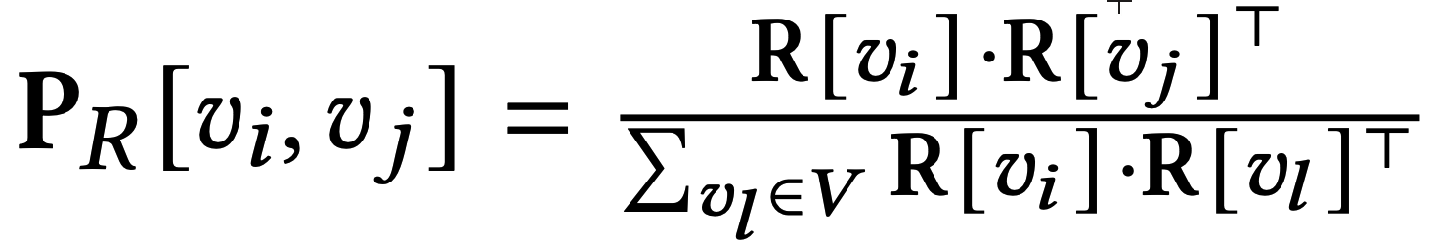
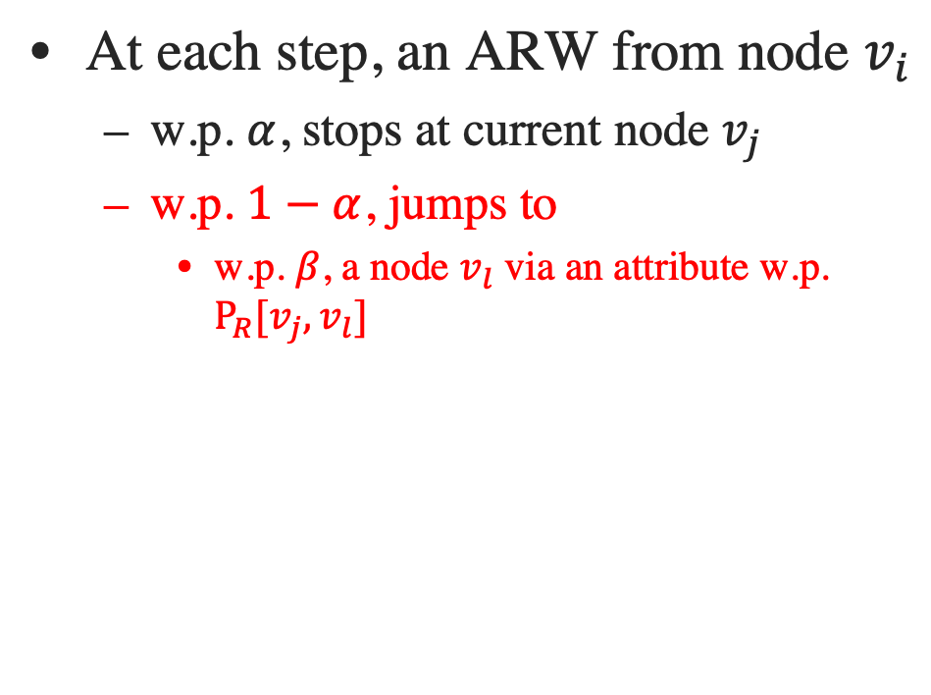
Objective: Attributed Random Walk Model
At each step, an ARW from node $v_{i}$
w.p. $α$, stops at current node $v_{j}$
w.p. $1−α$, jumps to
w.p. $β$, a node $v_{l}$ via an attribute w.p. $P_{R}[v_{j},v_{l}]$
Normalized attribute similarity of two modes
Notes:
Or with the other 1-alpha probability, the ARW with probability beta jumps to a node vl via an attribute with probability P_R[vj,vl].
Note that P_R[vi,vl] is the normalized attribute similarity between vi and vl, where R[vi] is the attribute vector of node vi. (click)

Slide 9
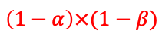
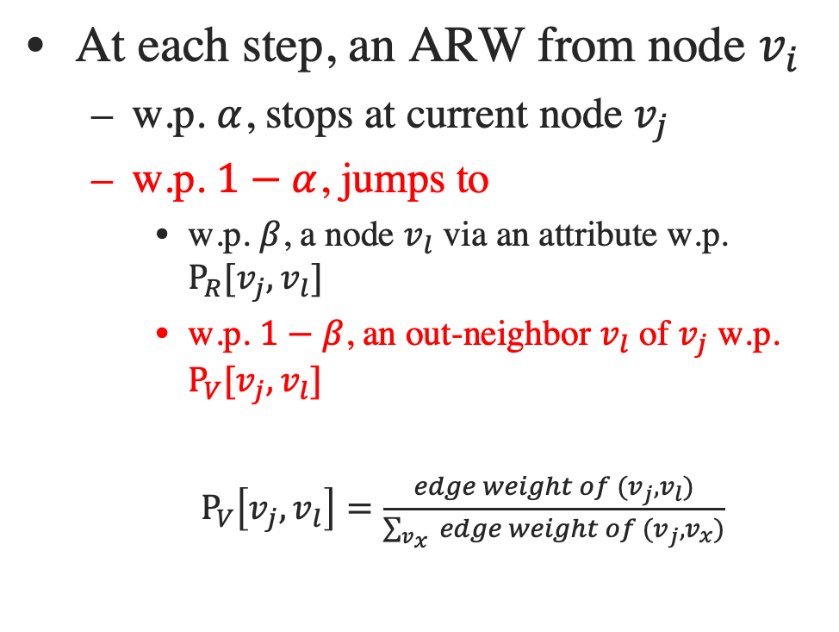
Objective: Attributed Random Walk Model
At each step, an ARW from node $v_{i}$
w.p. $α$, stops at current node $v_{j}$
w.p. $1−α$, jumps to
w.p. $β$, a node $v_{l}$ via an attribute w.p. $P_{R}[v_{j},v_{l}]$
w.p. $1−β$, an out-neighbor $v_{l}$ of $v_{j}$ w.p. $P_{V}[v_{j},v_{l}]$
$P_{V}\left[v_{j},v_{l}\right]=\frac{edge weight of (v_{j},v_{l})}{\sum_{v_{x} }{edge weight of (v_{j},v_{x})}}$
Notes:
With the other 1-beta probability, the ARW jumps to an out-neighbor node vl of vj with probability P_V[vj,vl].
Note that P_V is the weighted adjacency matrix of graph G, P_V[vj,vl] is the normalized weight of edge (vj, vl). If there is no edge connecting two nodes, the value is then 0. (click)

Slide 10
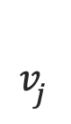
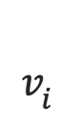
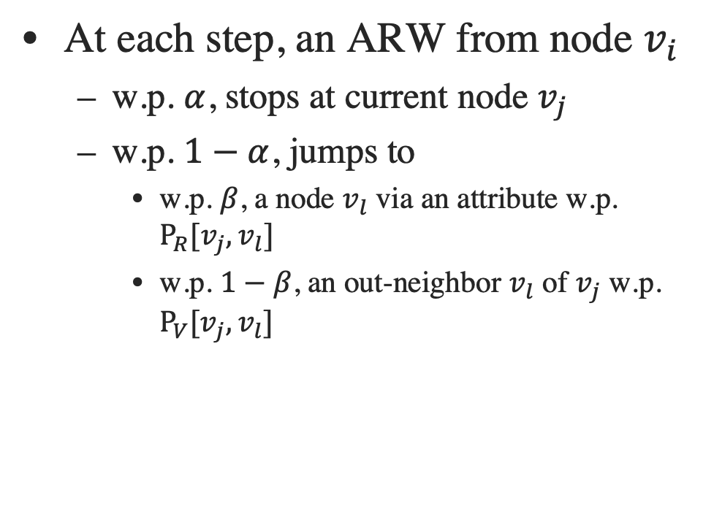
Objective: Attributed Random Walk Model
At each step, an ARW from node $v_{i}$
w.p. $α$, stops at current node $v_{j}$
w.p. $1−α$, jumps to
w.p. $β$, a node $v_{l}$ via an attribute w.p. $P_{R}[v_{j},v_{l}]$
w.p. $1−β$, an out-neighbor $v_{l}$ of $v_{j}$ w.p. $P_{V}[v_{j},v_{l}]$
$$v_{i}$$
$$v_{j}$$
The probability that a ARW from stopping at :
Notes:
After doing some math, the probability of an ARW from vi to vj actually can be computed as S[vi,vj] by this equation. We see that ARW well combines the multi-hop topological proximities between nodes with the multi-hop attribute similarities between nodes.
Obviously, it is a high cost to compute S. (click)

Slide 11
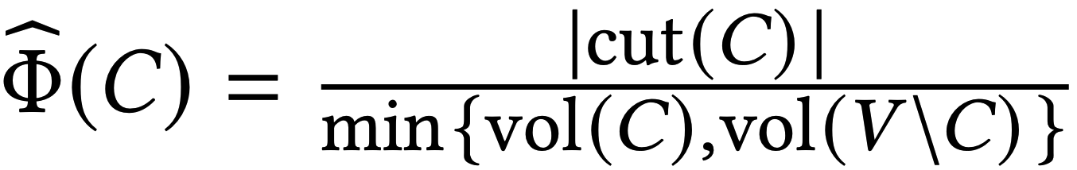
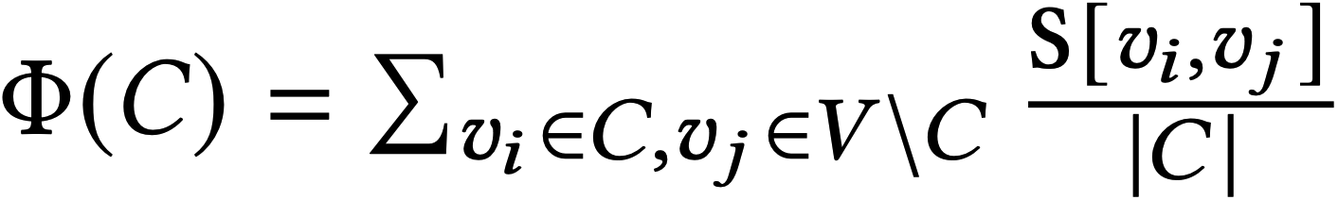
Objective: Average Attributed Multi-Hop Conductance (AAMC)
Conductance
AAMC
|cut(C)|: #edges crossing C and other clusters
|vol(C)|: #edges of nodes within C
v4 is mutually connected to &
shares 3 attributes with v2, v3
The ratio of edges crossing C
v2, v3 & v4 should be in the same cluster
Avg. conductance:
(a) 4/12; < (b) 4/10.
×
the expected portion of attributed
random walks escaping from C
AAMC:
(a) 0.123; > (b) 0.105.
✓
Notes:
Classic graph clustering methods use conductance to measure the quality of a cluster C. The conductance of C is essentially the ratio of edges crossing the cluster C and other clusters. We note that it only consider edges. (click)
Inspired by this, we define the Average Attributed Multi-Hop Conductance, the Attributed Multi-Hop Conductance is defined as the expected portion of attributed random walks escaping from if we conduct a large number of random walks from nodes in C. The AAMC is the average Attributed Multi-Hop Conductance of all clusters in the graph. (click)
Consider the right-hand-side example. Each black nodes are users and blue nodes are attributes, black edges are friendships and blue edges are node-attribute associations. Observe that user v4 has mutual friendships with users v2,v3 and shares 3 common attributes with users v2, v3. Intuitively, v2,v3, and v4 should be in the same cluster and the left-hand-side clusters are better than the right-hand-side ones. (click)
However, if we use classic conductance as the measurement of clustering quality. It suggests that the right-hand-side ones are better, which is counterintuitive。
In comparison, AAMC gives the desired result and thus is more effective. (click)

Slide 12
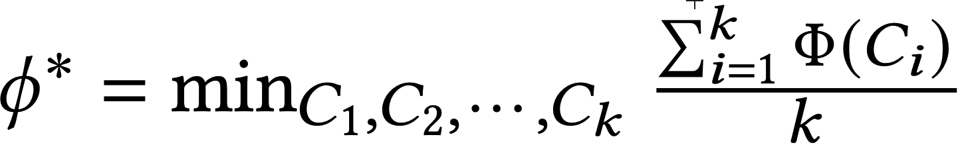
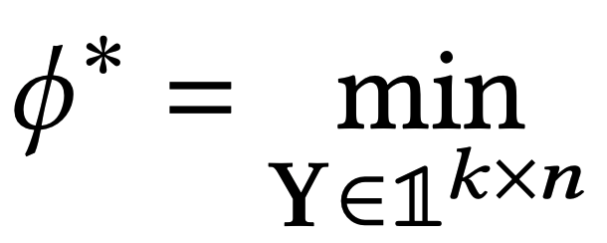
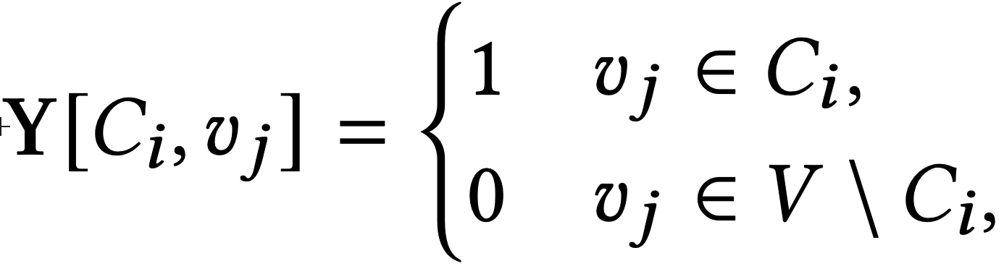
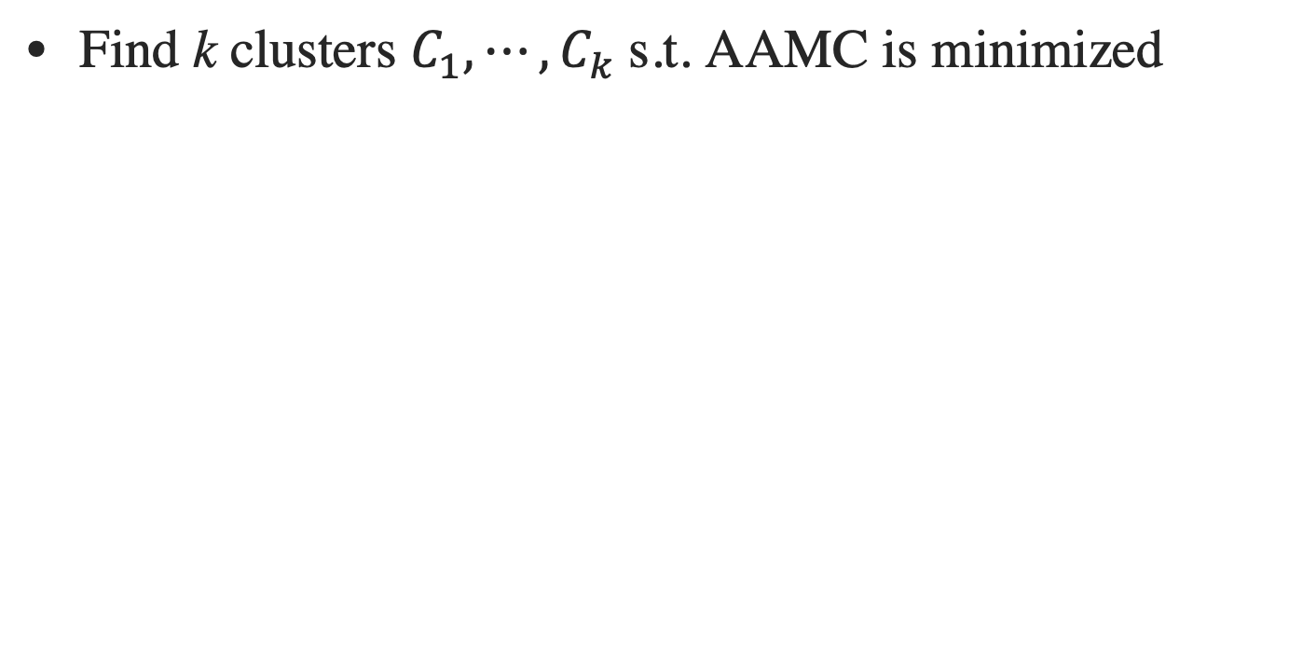
Objective: Objective Function
Find k clusters $C_{1},⋯,C_{k}$s.t. AAMC is minimized
Notes:
Therefore, we formulate our objective function to k-AGC problem based on AAMC. Namely, we aim to find k disjoint clusters that minimize the AAMC. (click)
Again, after doing some math, the problem is transformed into a mathematical form, which aims to find a k tims n indicator matrix Y minimizing the trace of the matrix product as shown in the formula. For each node vj, there is only one entry among k dimensions can be 1, and other entries are all zero. (click)

Slide 13
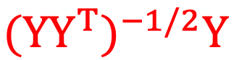
Proposed ACMin: Basic Idea
×
F
F
₁
optimal when F is the top-k eigenvectors of S
find Y such that approximates F
2
Notes:
Directly solving the objective is NP-hard. (click)
Hence, we turn to solve a relaxed version. That is, we do not require Y being an indicator matrix and replace the Y related part via a matrix F. (click)
We proved that the relaxed objective is optimal when matrix F is the top-k eigenvectors of matrix S, which means we can first find the top-k eigenvectors of S. (click)
And then, find an indicator matrix Y such that (YY^T)^-1/2Y approximates F well. More specifically, the second step is to solve the objective function as shown in the bottom formula. (click)

Slide 14
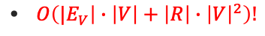

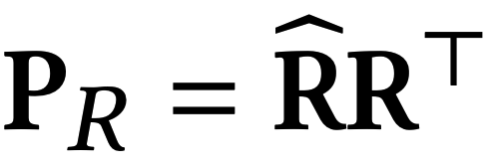
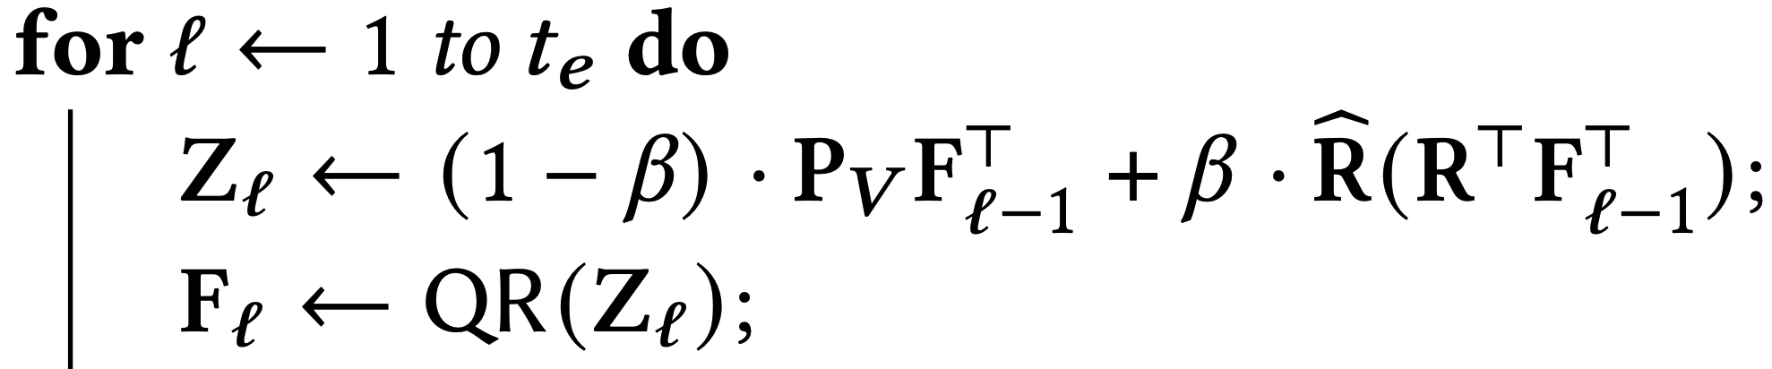
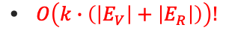
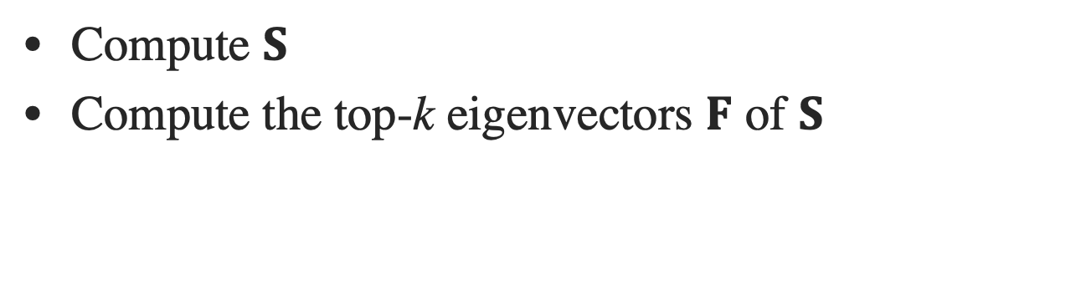
Proposed ACMin: Find F
×
Compute $S$
Compute the top-k eigenvectors $F$ of $S$
𝐅 is the top-k eigenvectors of !
orthogonal iterations
Notes:
in order to find F, the straightforward way is to compute the matrix S first and then compute the top-k eigenvectors of S as F. (click)
Recall that the computation of S involves quadradic time and space overheads. This is highly inefficient. (click)
However, we can prove that F is equivalent to the top-k eigenvectors of the linear combination of P_V and P_R. P_V is the weighted adjacency matrix of graph G. (click)
The matrix P_R can be decomposed into the inner product of two low-dimensional matrices. (click)
As a result, by applying orthogonal iterations, we are able to find F in linear time and space. (click)

Slide 15
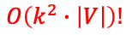
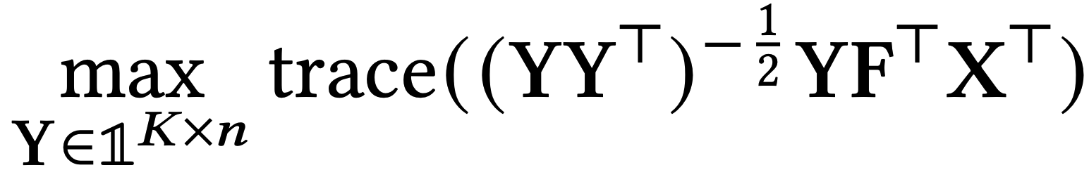
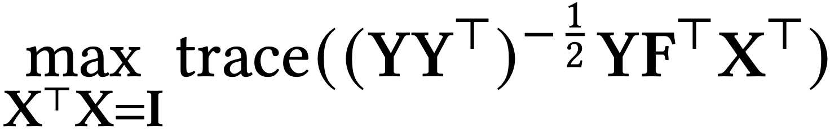
Proposed ACMin: Find Y
Alternative optimization
Updating Y with X fixed:
Updating X with Y fixed:
better
Find F
Find Y
Compute
AAMC of Y
Set Y as the
current best result
no better than current best result
Notes:
With F, we can find Y, namely the clustering result, using an alternative optimization process, which runs in linear time. (click)
To summarize, the ACMin algorithm runs iteratively. In each iteration, it first computes an approximate top-k eigenvectors F and then based on it computes Y. After that, ACMin checks if the Y achieves a better AAMC score compared to the current best result. If yes, it updates Y as the best result. Then, it enters into the next iteration. (click)

Slide 16
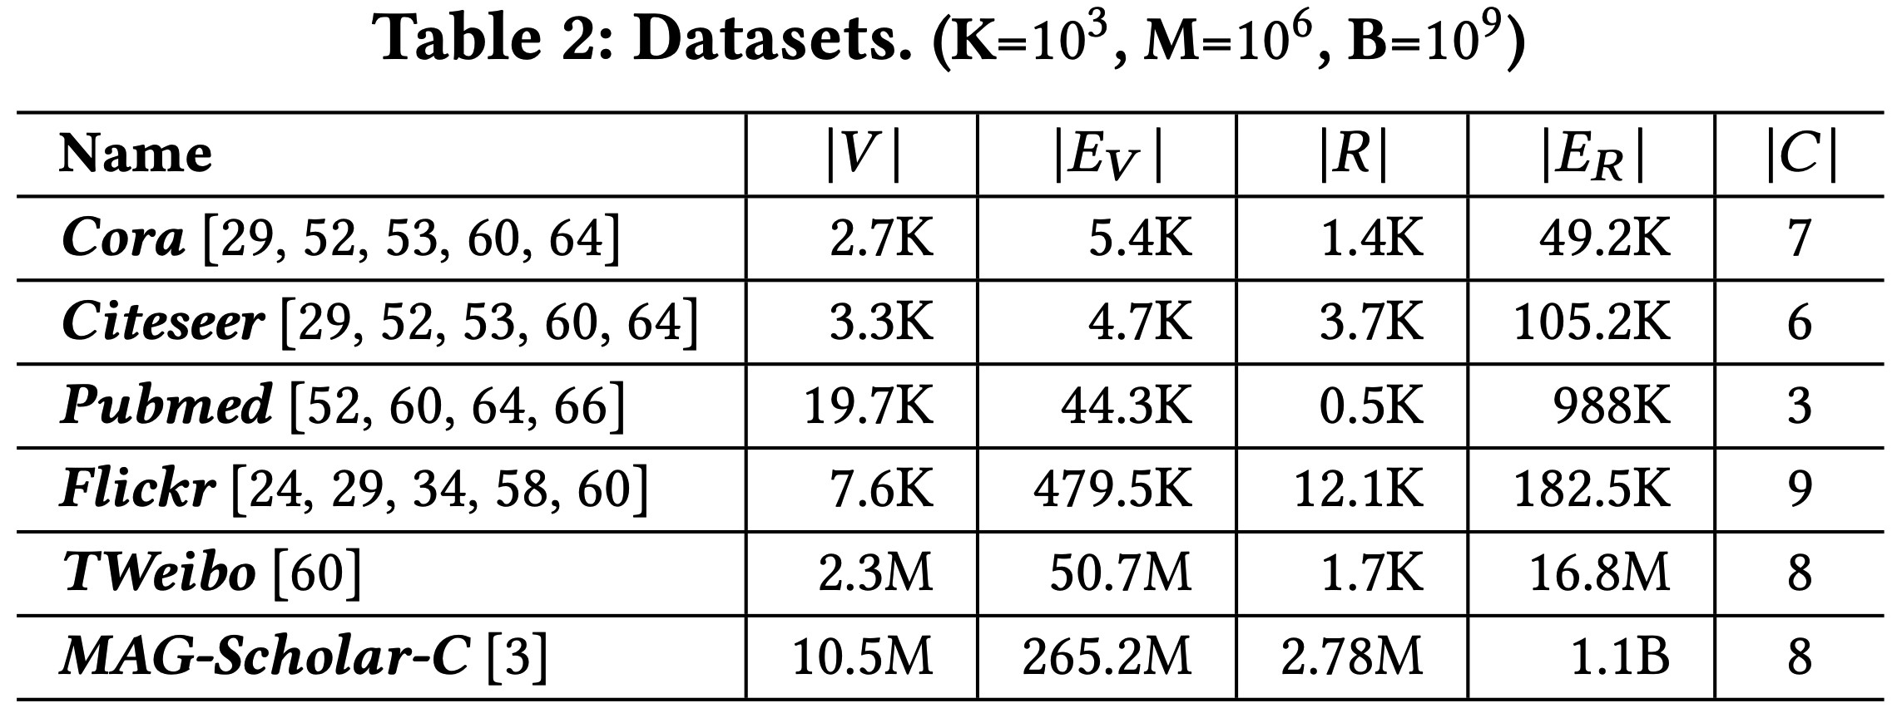
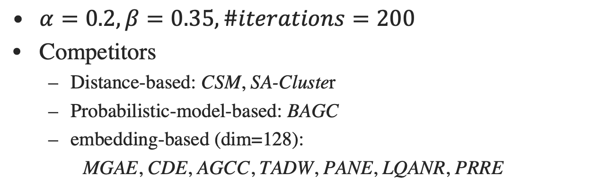
Experiments: Datasets and Setup
$α=0.2, β=0.35, \#iterations=200$
Competitors
Distance-based: CSM, SA-Cluster
Probabilistic-model-based: BAGC
embedding-based (dim=128):
MGAE, CDE, AGCC, TADW, PANE, LQANR, PRRE
Notes:
(click) We experimentally evaluate the efficiency and clustering quality of proposed ACMin against 10 competitors on six datasets, including small and large attributed graphs. (click)

Slide 17
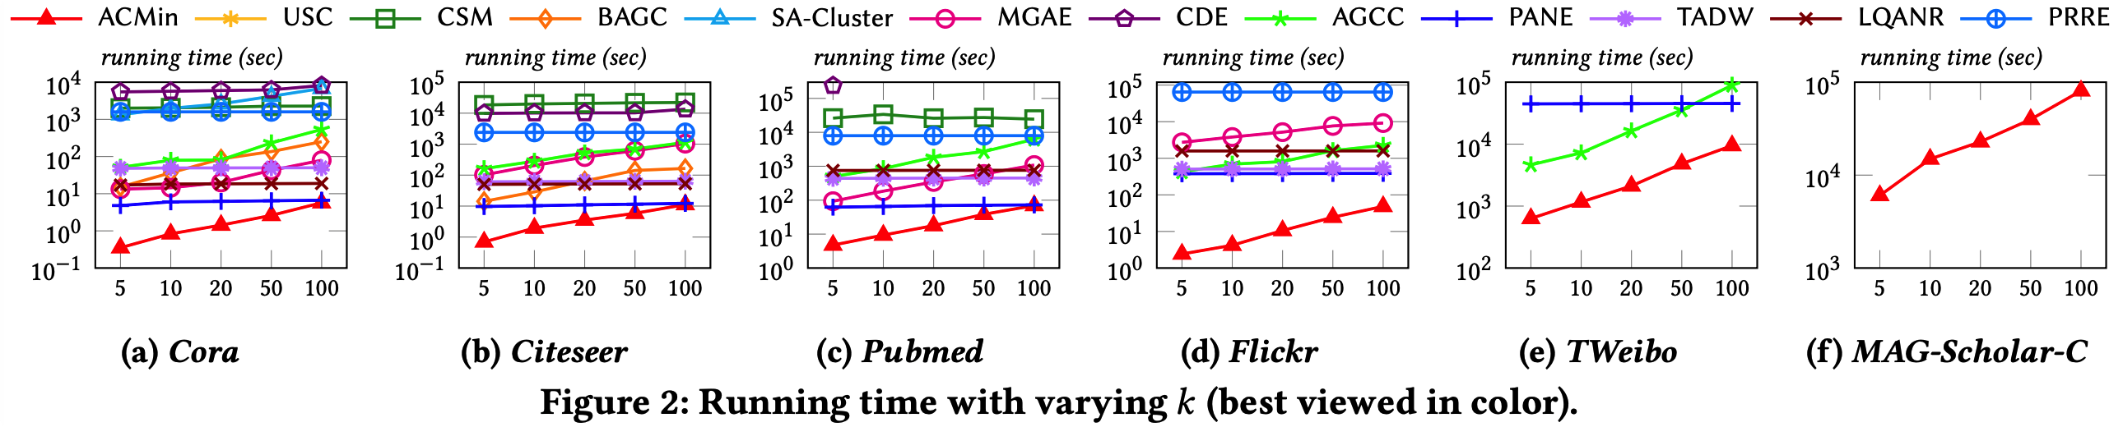
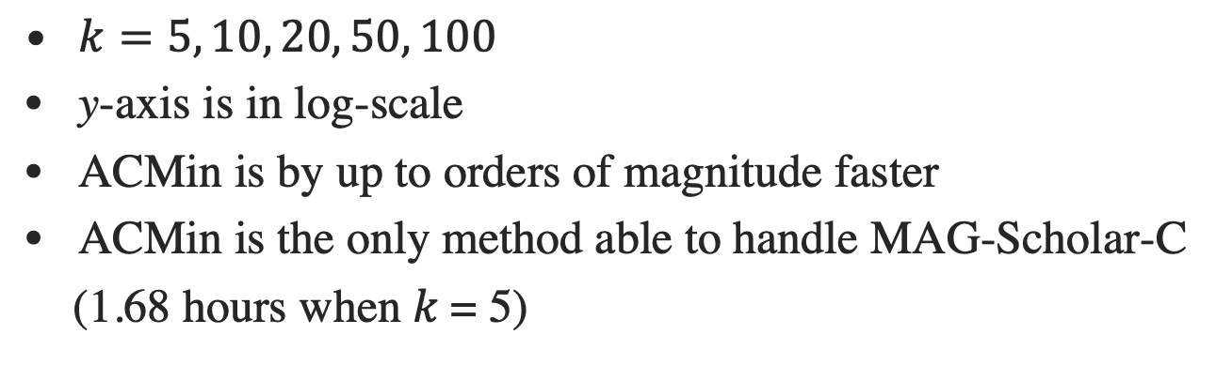
Experiments: Efficiency
$k=5, 10, 20, 50, 100$
y-axis is in log-scale
ACMin is by up to orders of magnitude faster
ACMin is the only method able to handle MAG-Scholar-C
(1.68 hours when 𝑘 = 5)
Notes:
(click) We observe that ACMin outperforms other methods by up to orders of magnitude faster when varying the number of clusters k from 5 to 100.
Especially, ACMin is the only method that is able to process MAG dataset within two days. (click)

Slide 18
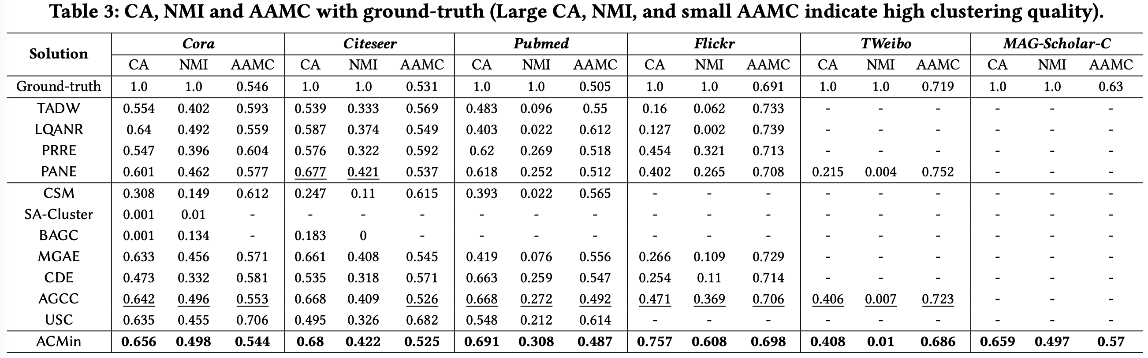
Experiments: Clustering Quality with Ground-truth
CA: clustering accuracy w.r.t. ground truth labels
NMI: normalized mutual information
AAMC
Notes:
(click) We use the node lables in the attributed graphs as the ground-truth clusters, and compute the accuracy and NMI scores of all methods. It can be observed that ACMin consistently achieves the best performance. (click)

Slide 19
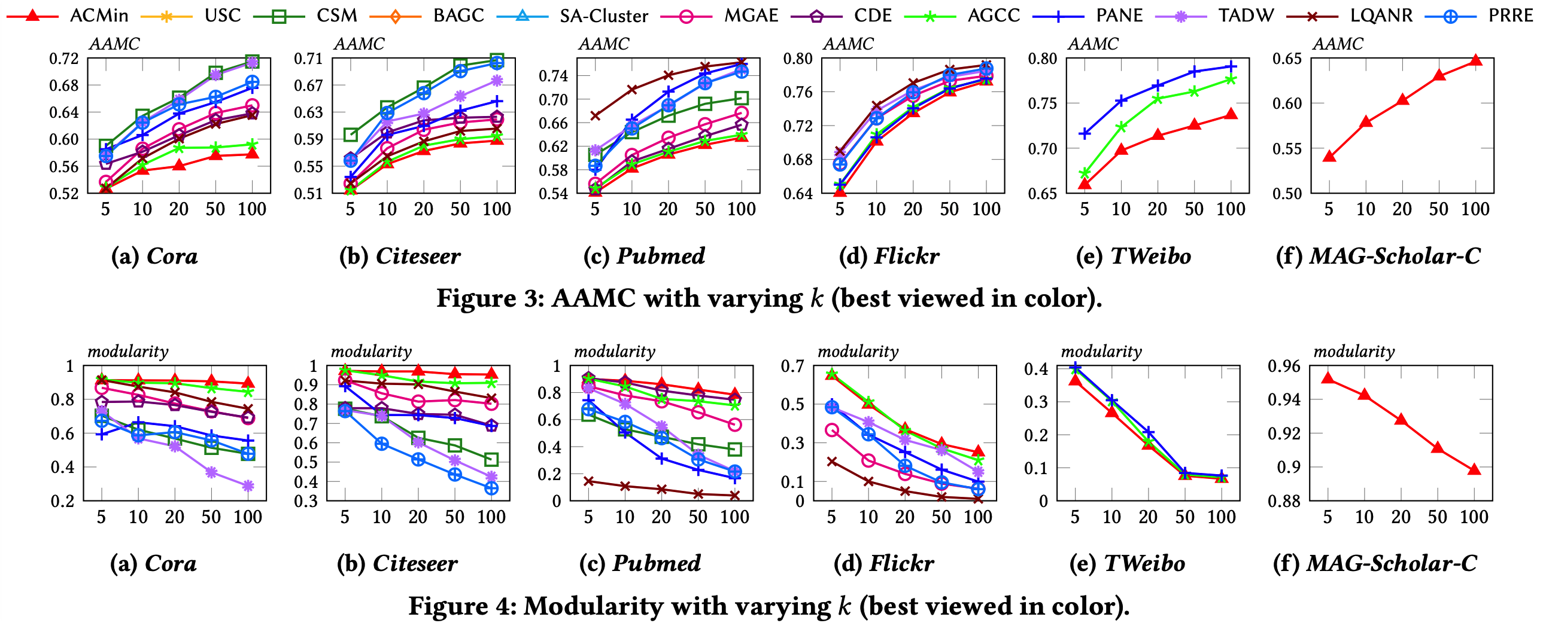
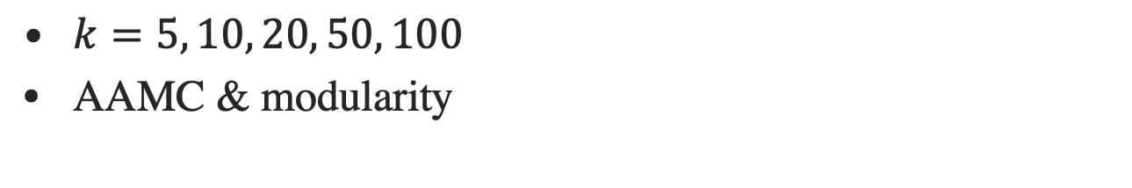
Experiments: Clustering Quality without Ground-truth
$k=5, 10, 20, 50, 100$
AAMC & modularity
Notes:
(click) In terms of the classic clustering metrics without ground-truth clusters, namely modularity and our proposed AAMC metric, we observe that ACMin is still the best method. (click)

Slide 20
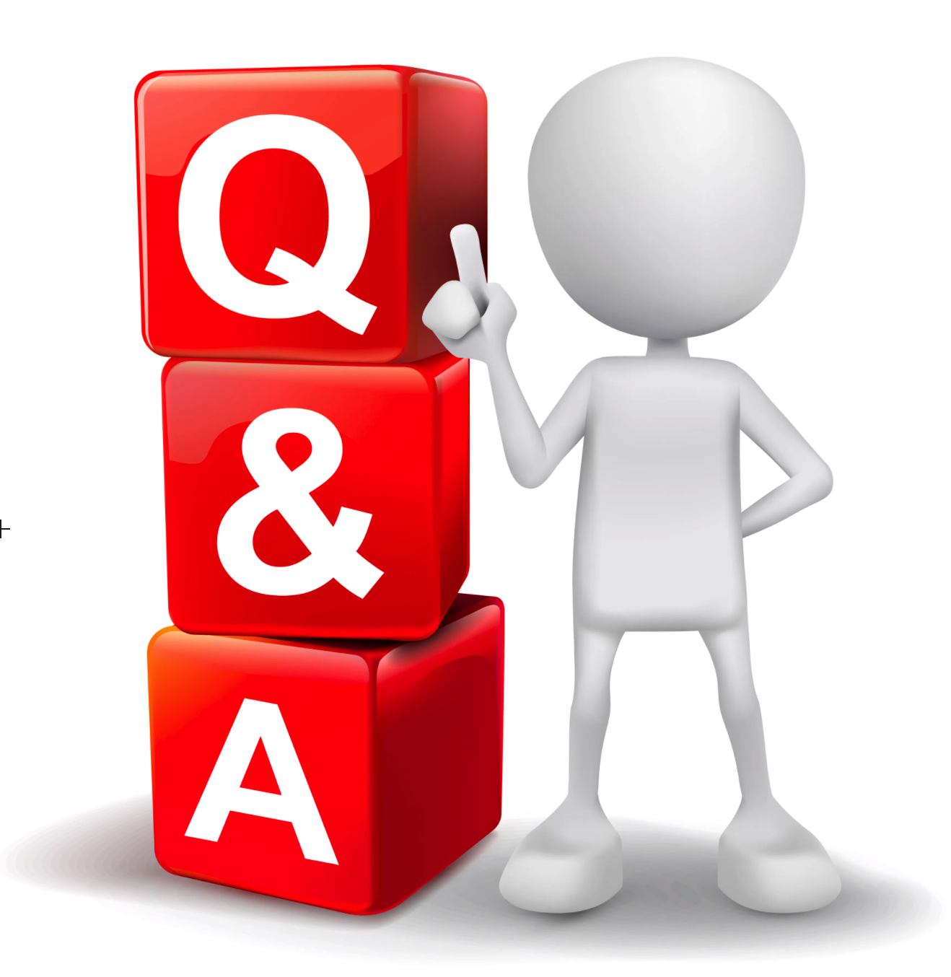
Thank You!
Notes:
Thanks for listening. Any questions?

Slide 21
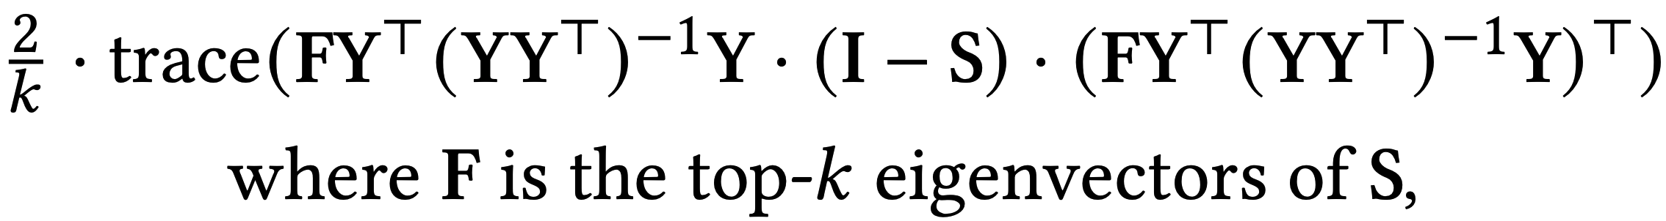
Comparison with Spectral Clustering
Spectral clustering applies k-means to generate Y
Spectral clustering optimizes
In contrast, ACMin optimizes

Slide 22
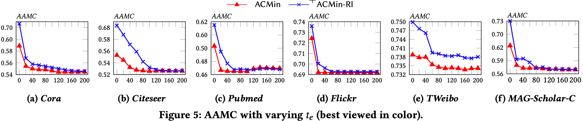
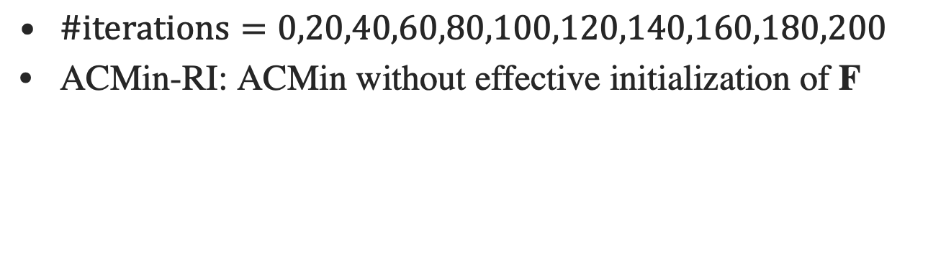
Experiments: Convergence Analysis
$\#iterations=0,20,40,60,80,100,120,140,160,180,200$
ACMin-RI: ACMin without effective initialization of F

